Slide 1


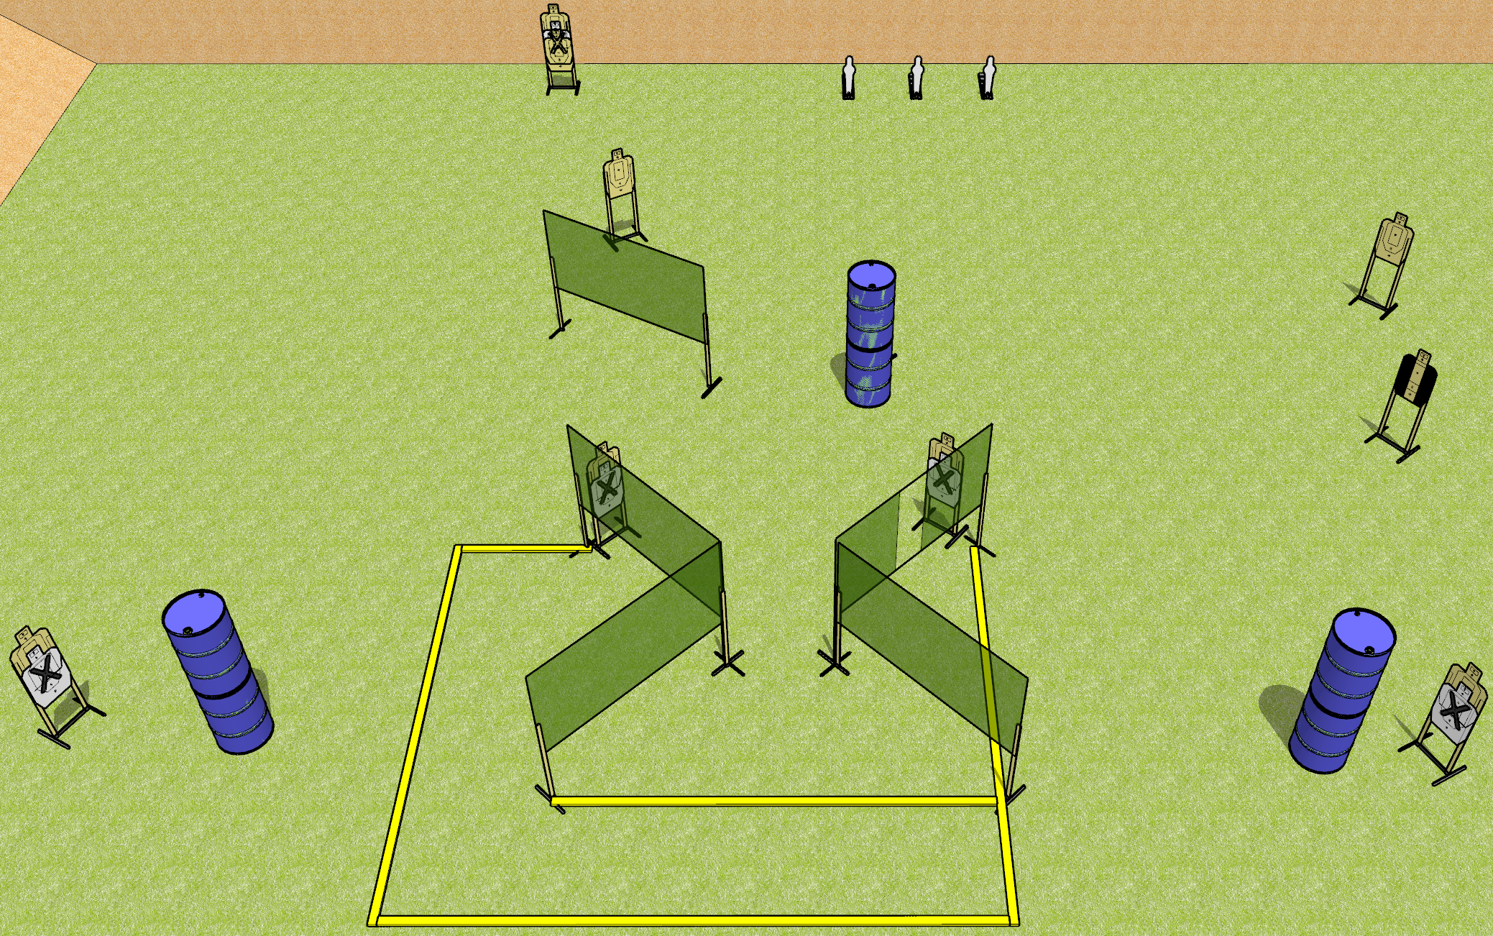
 | Dothan Gun Club – USPSA Match Bringing the Pain Course Designer : Drew Coleman
START POSITION : Standing anywhere inside the shooting area, wrists below belt
GUN READY CONDITION : Pistol loaded and holstered. PCC loaded, held with both hands, stock on belt, safety on. |  | SCORING: Comstock, 23 rounds TARGETS: 10 paper, 3 Steel SCORED HITS: Best 2 on paper, steel until down START-STOP: Audible, last shot RULES: (setup note: target with NS behind the center barrel)
STAGE PROCEDURE: Engage targets as they become available from within the fault lines.

Slide 2
Bringing the Pain
Written Stage Briefing
Bringing the Pain is a 23 round, 115 point, Comstock field course. There are 10 USPSA targets and 3 USPSA mini poppers. The best two hits on paper will score, and steel must fall to score. The start signal is audible.
Handgun start position is anywhere inside the shooting area, wrists below belt. Handgun is loaded and holstered.
PCC start position is anywhere inside the shooting area. Loaded carbine is held with both hands, stock on belt, safety on.
On start signal, engage targets as they become available from within the shooting area.

